Slide 1
Gender Detection
Marcus Lee

Slide 2
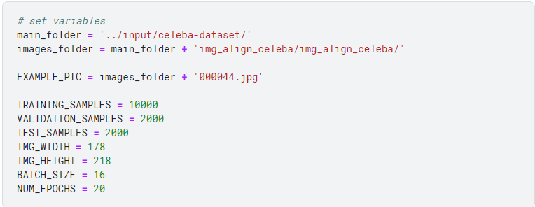
Data Exploration
IMG_WIDTH, IMG_HEIGHT: These specify the width and height of the images. The CelebA dataset images have a resolution of 178x218 pixels. Consistent image dimensions are important for training neural networks as they require fixed-size input.
BATCH_SIZE: In machine learning, especially in training deep learning models, data is often processed in batches. This variable sets the batch size to 16, meaning that 16 images will be processed at a time during training.
NUM_EPOCHS: An epoch is one complete pass through the entire training dataset. This variable sets the number of epochs to 20, meaning the learning algorithm will work through the entire dataset 20 times.

Slide 3
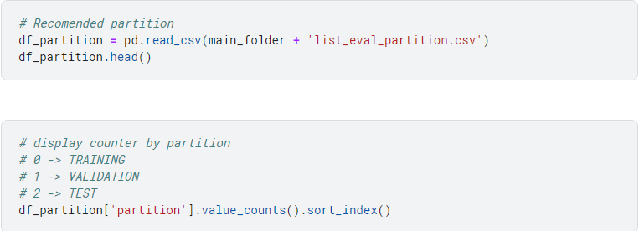
Split Dataset into Training, Validation and Test
splitting the dataset into distinct training, validation, and test sets is essential for training robust and generalizable machine learning models. The approach outlined in your code follows this best practice, adapting it to manage computational resources effectively.

Slide 4
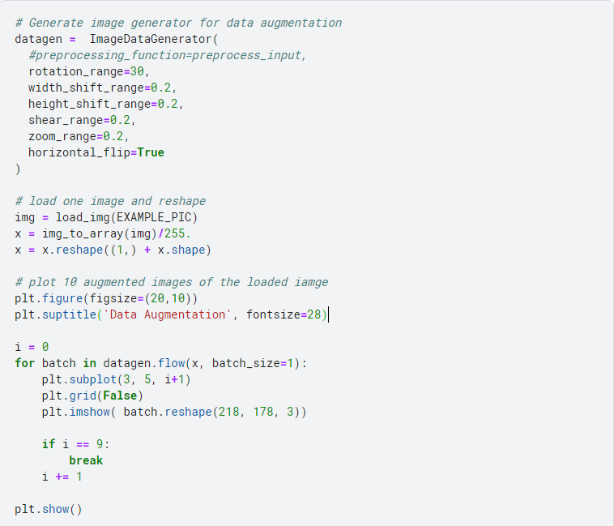
Data Augmentation
Data augmentation refers to the technique of creating new training samples from the existing ones by applying random, yet realistic, transformations. This is especially useful in image processing.
rotation_range=30: Rotates the image by up to 30 degrees.
width_shift_range=0.2 and height_shift_range=0.2: Shifts the image either horizontally or vertically by 20% of its width or height.
shear_range=0.2: Shears the image by 20%.
zoom_range=0.2: Zooms into the image by up to 20%.

